Slide 1




Services
Angular Basics

Slide 2

Table of Contents
What is a service
Why using services
Custom services
Built-in services

Slide 3

What Is a Service

Slide 4

What Is a Service
In Angular service is
A worker object
Easier use of different aspects of the app
Over-the-Wire or not
Often stateless

Slide 5

Why Using Services

Slide 6


Why Using Services
Services are:
Reusable
"SOLID"
Dependency Injection
Testable

Slide 7

Custom Services

Slide 8
Custom Services
Three types
Factory – the returned value
Service – returns instance of the function
Provider – can be configured
module.service('serviceName', function (args) {
// implement service
});
module.provider('providerName', function (args) {
// implement service
});

Slide 9
Custom Services
Inject it in a controller
module.factory('serviceName', function (services){
// implement service
// return object or function
});
myApp.controller('Ctrl',
function Ctrl($scope, serviceName) {
// use service
}
);

Slide 10
Custom Services Example
Logger example
angular.module('myApp', [])
.factory('logger', function () {
return {
log: function (message) {
console.log(message);
},
};
})
.controller('Home', function (logger) {
logger.log('test');
});

Slide 11
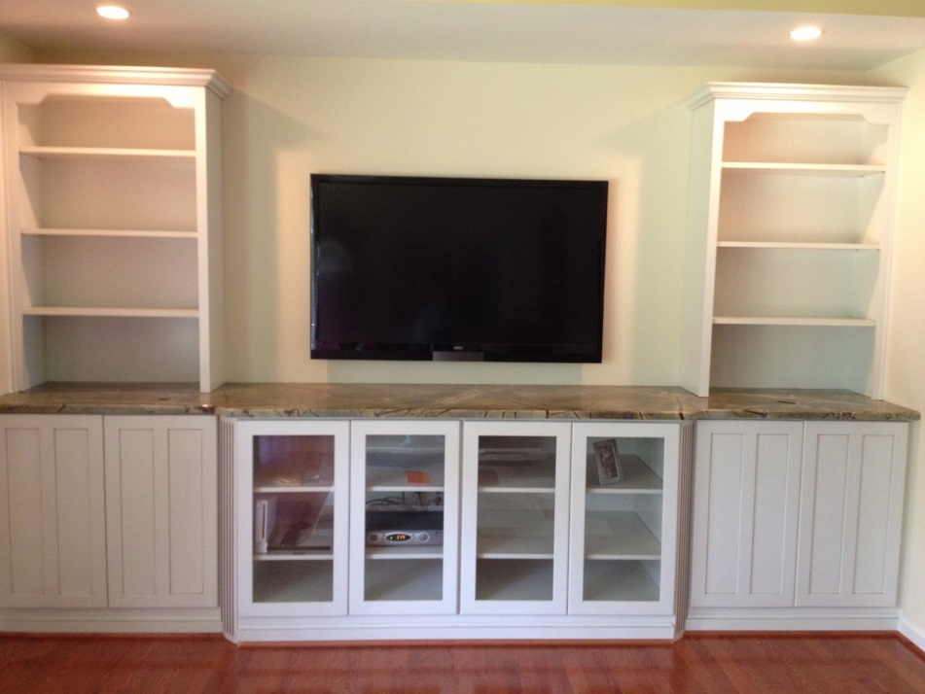
Built-in Services

Slide 12
Using $http
Using $http
myApp.controller('Home', function ($http) {
var vm = this;
$http.get('http://api.github.com')
.then(function (result) {
vm.data = result.data;
});
$http.post('someurl', { data: 5 })
.then(function (result) {
console.log('success');
});
});

Slide 13
Using $q
Built-in Services
myApp.factory('myPromise', function ($http, $q) {
return {
get: function get() {
var deferred = $q.defer();
$http.get('http://api.github.com')
.then(function (result) {
deferred.resolve(result.data);
});
return deferred.promise;
}
};
})

Slide 14
Built-in Services
Built-in Services
$http – AJAX request
$resource – AJAX with restfull services
$q – Promise library
$anchorScroll – Scrolls to element
$cacheFactory – cache service (key-value pair)
$compile – compiles element with directives
$parse – parses expressions
$locale – localization of dates, numbers
$timeout – timeout with compiling
$exceptionHandler – handling exceptions
$filter – access to filter functions
$cookieStore – cookie sessions usage

Slide 15
Built-in Services
Other Built-in Services
$interpolate – modifies the {{ template
$log – logs into the console
$rootScope – the "base" scope (avoid using it)
$window – the window
$document – the document DOM element
$rootElement – the root of the app
$route – for routes
$routeParams – retrieve route parameters
$location – parses the URL
$httpBackend – fake HTTP (for testing)
$controller – instantiates controllers

Slide 16
Summary
Angular services
Custom services
Built-in services

Slide 17
AngularJS
http://academy.telerik.com

